Slide 1
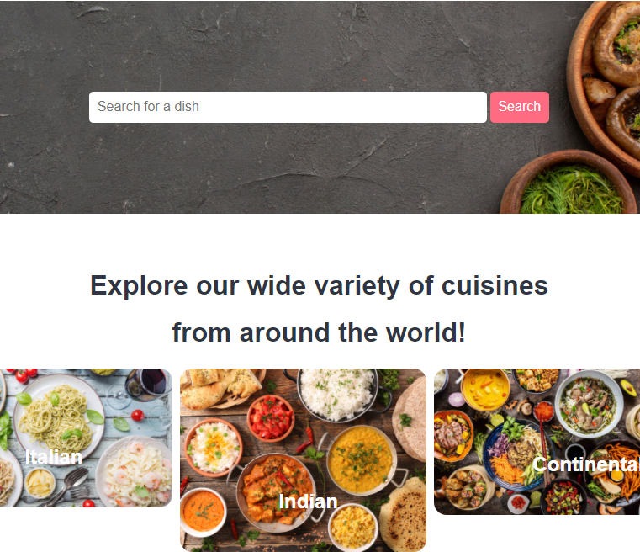

SQL Project- Web Application
MINI PROJECT:
FOOD ORDERING SYSTEM
2018B2A20608H – SUYASH SRIVASTAVA

Slide 2
Food Ordering System
Domain Description
I am building a web application for a Restaurant Food order management, which can handle customers and managers. There will be an admin panel which handles and manages the food orders. The admin panel will comprise of login, authentication, updating, deletion of the admins/managers which will take and process the food orders. For the customer part, our website will be public. Customers will be able to choose their food choice and order anything and will be able to place order, after giving necessary details like phone number, address, contact, name, email. The admin panel dashboard will be able to see all the orders details when placed, with the status of order, order date, Customer ID(Unique), and other details entered by the customer. There will also be an update/delete order section in Admin panel where if customer wants to cancel order, it will be allowed to do so. Admin panel will also be able to add/delete/update the meals like Drinks, or update the rates, if necessary.

Slide 3
Food Ordering System
Functionality Supported
Admin Panel
Manage Orders- Add/ Update/ Delete Meal details
Manage Admin- Add/Delete/Update Admin details
Summary page with order details
Login- Logout with necessary validation
Customer Panel
Search Meal
Dashboard with Place order
Screens/ GUI Layout
Admin- Login->Admin Panel-> To all other pages like manage order, admin, summary
User-Customer Dashboard->(If chosen a meal) Order Placement Page->End result Page(Order Placed Successful/Unsuccessful)

Slide 4
Food Ordering System
Technology used
RDBMS-MySQL
Programming- PHP
phpMyAdmin -software tool written in PHP, intended to handle the administration of MySQL over the Web, It supports operations like managing databases, tables, columns, relations, indexes, users, permissions, etc. can be performed via the user interface, apart from the usual ability to directly execute any SQL statement.
XAMPP is a free and open-source cross-platform web server solution stack package developed by Apache Friends, consisting mainly of the Apache HTTP Server, MariaDB database, and interpreters for scripts written in the PHP.
Using the XAMPP app, you can run Apache web server as your local server and MySQL as your database server

Slide 5
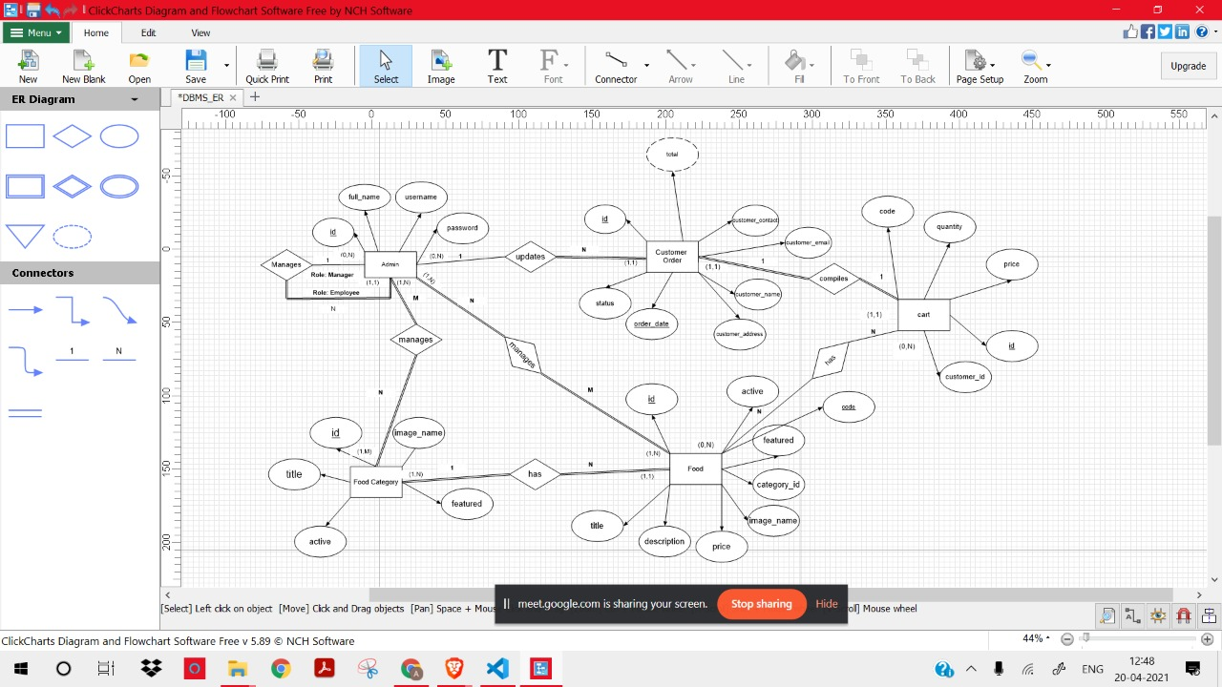

Slide 6
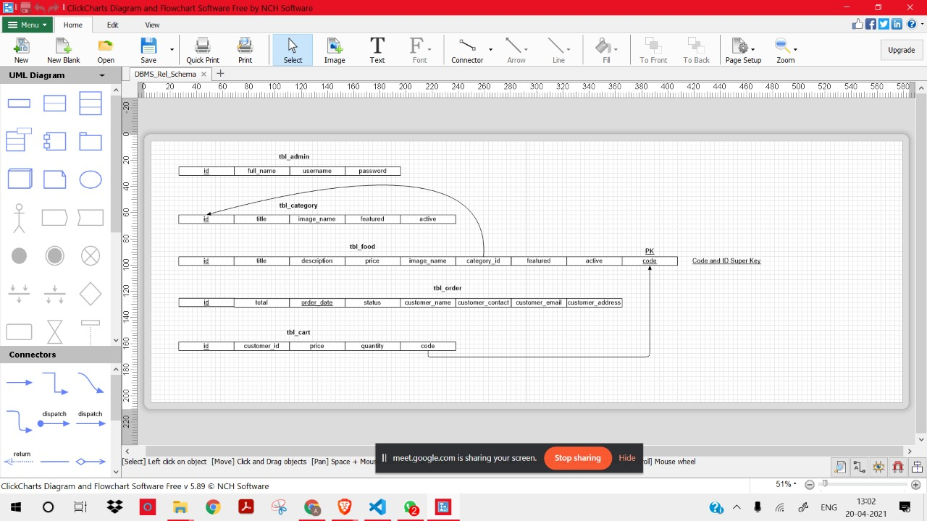

Slide 7
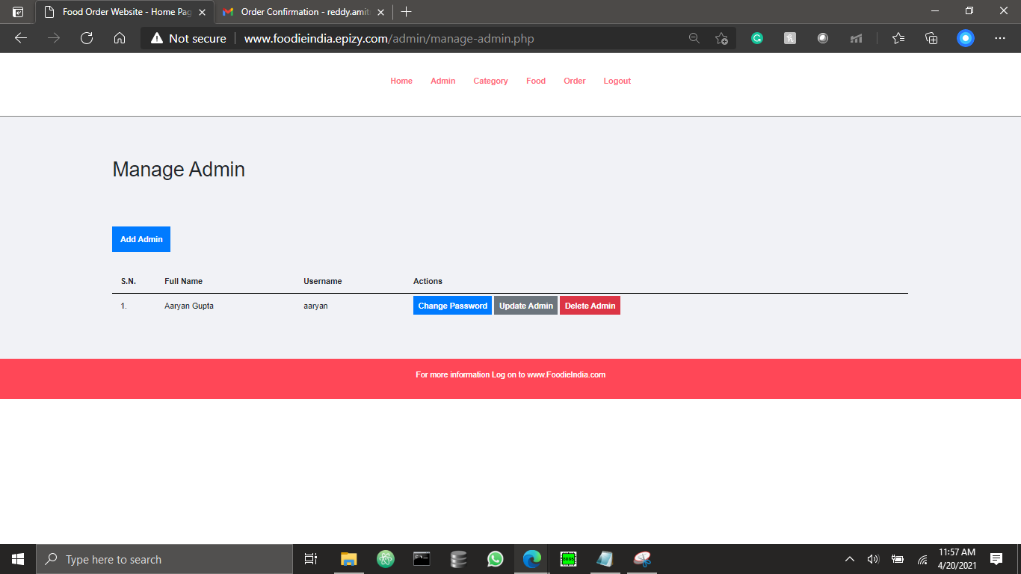
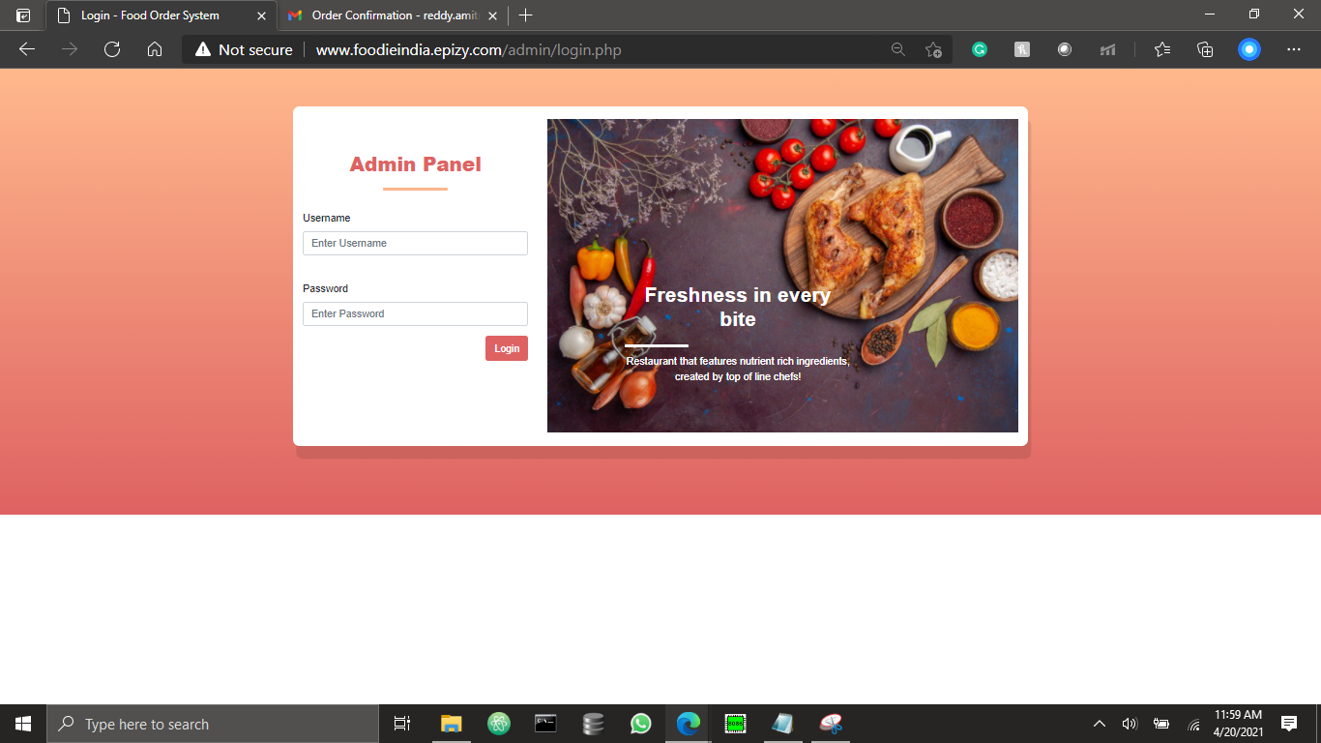
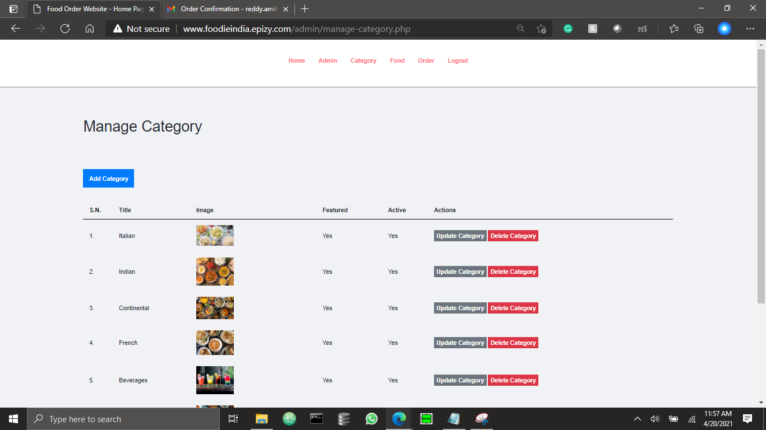
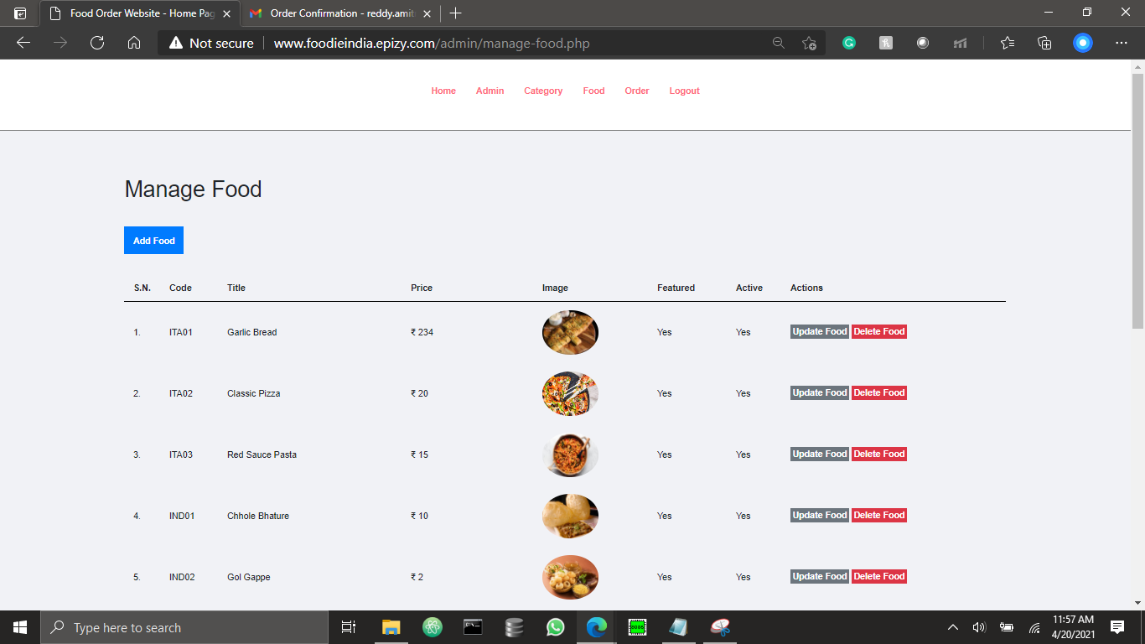
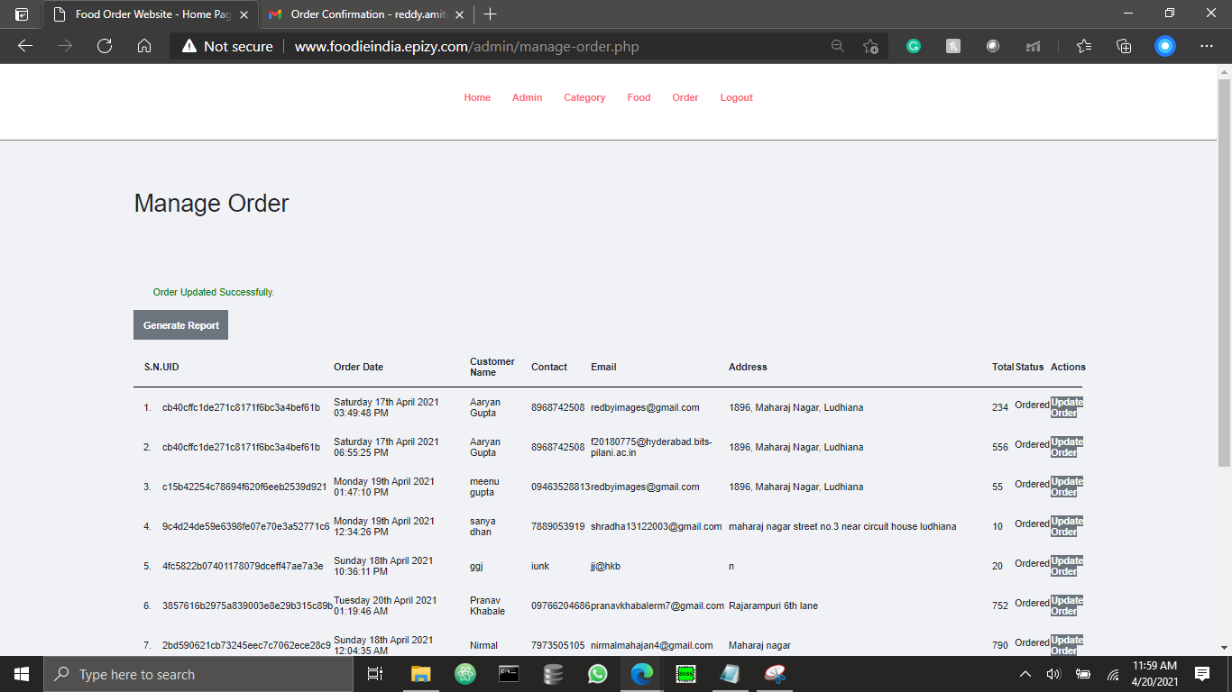
ADMIN PANEL

Slide 8
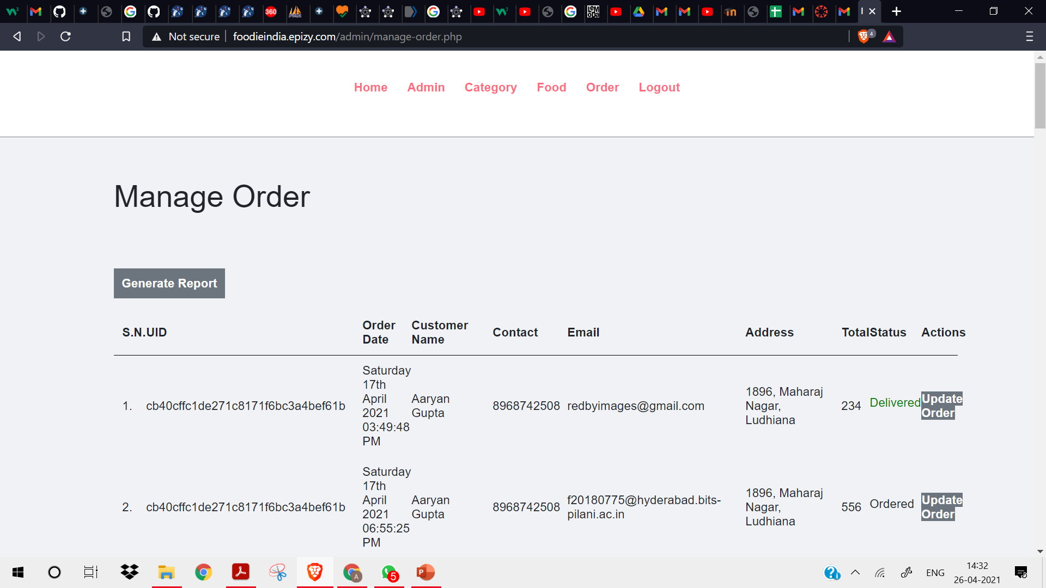
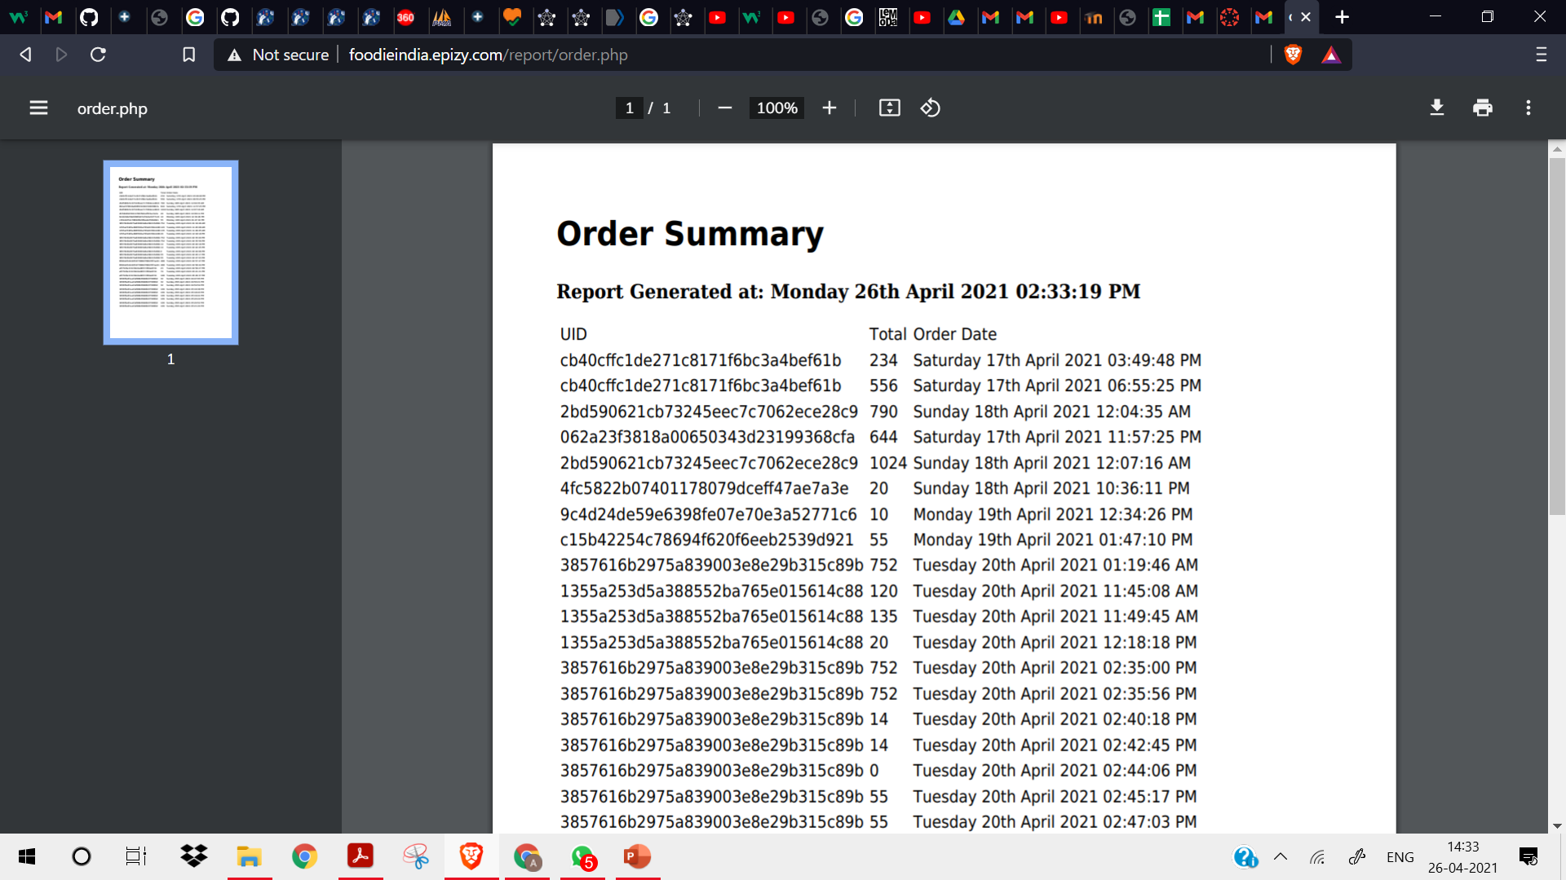
Report Generation

Slide 9
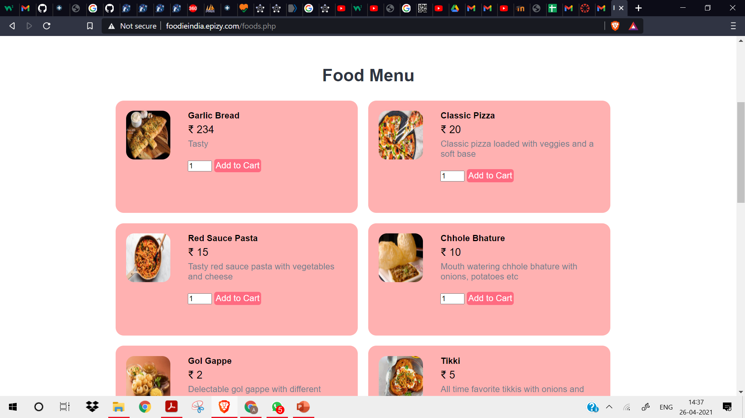
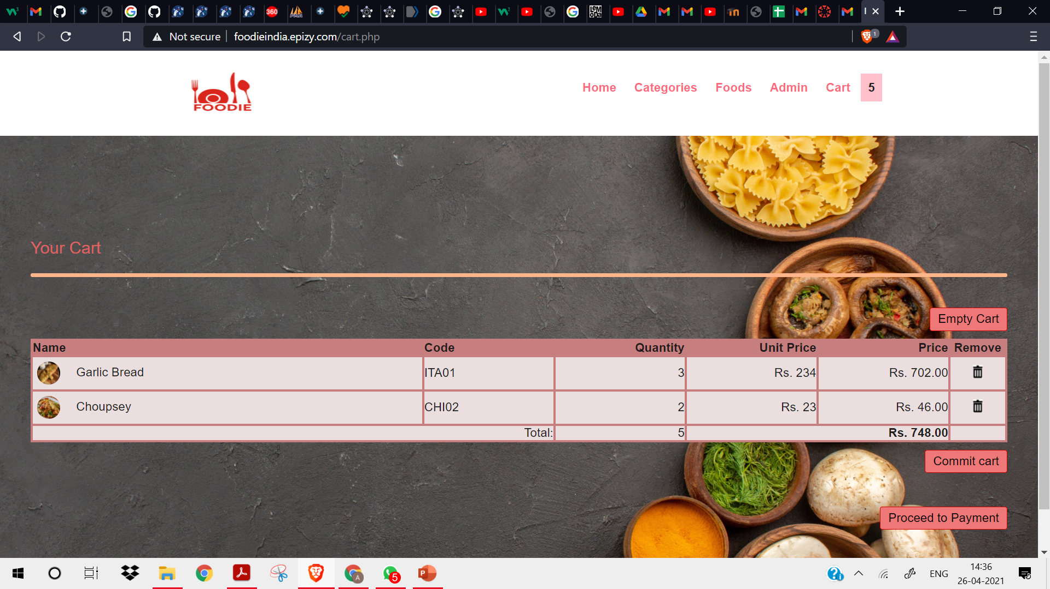
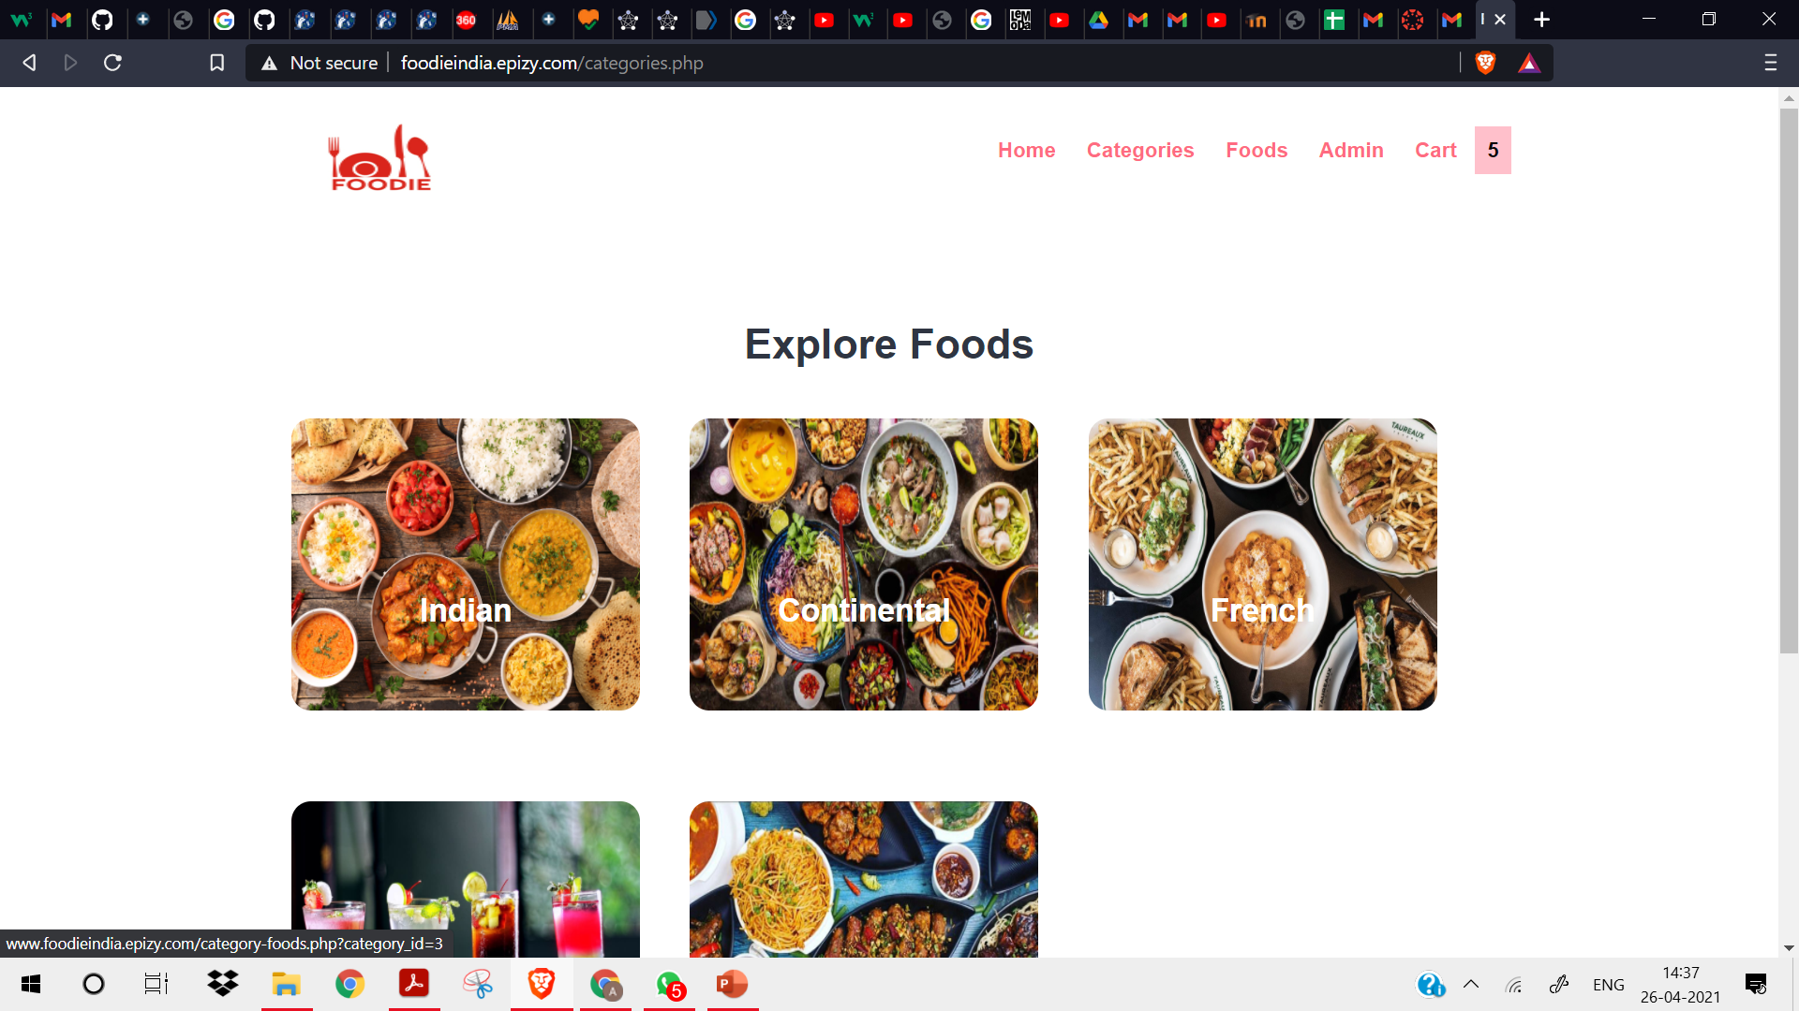
Cart Functionality
Select Food from Food menu or through categories
Cart total qty
Commit to cart
Empty Cart
Remove from cart

Slide 10
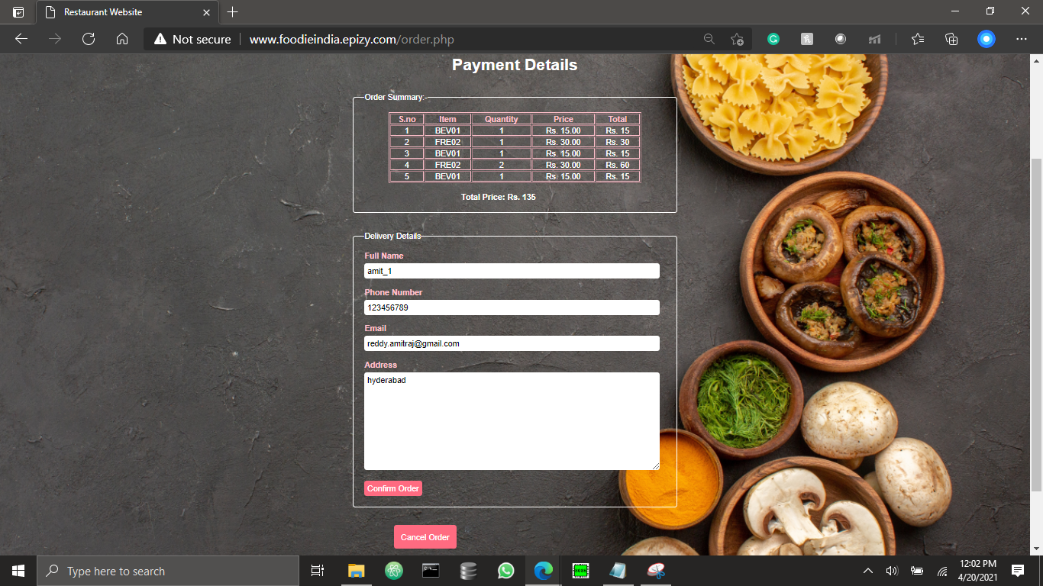
Order Confirmation
Confirm Order
Cancel Order
Enter Valid details

Slide 11
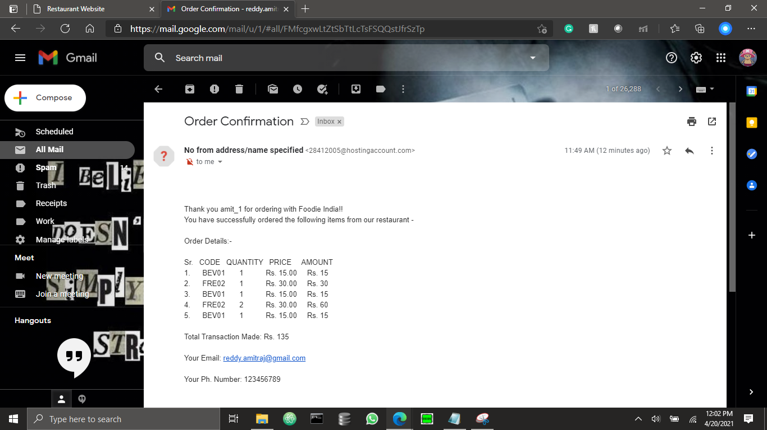
Order Confirmation through Email (Used SMTP: port 465) and mail function in php using SQL queries for customization

Slide 12
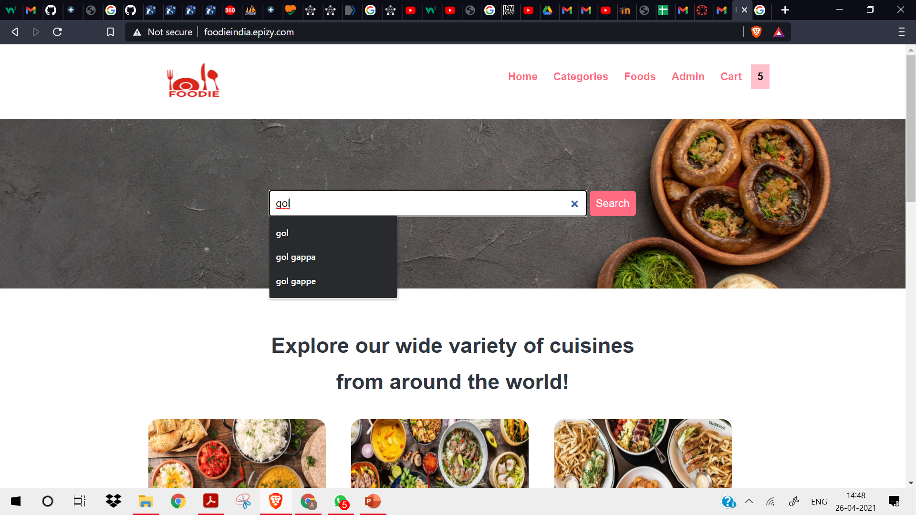
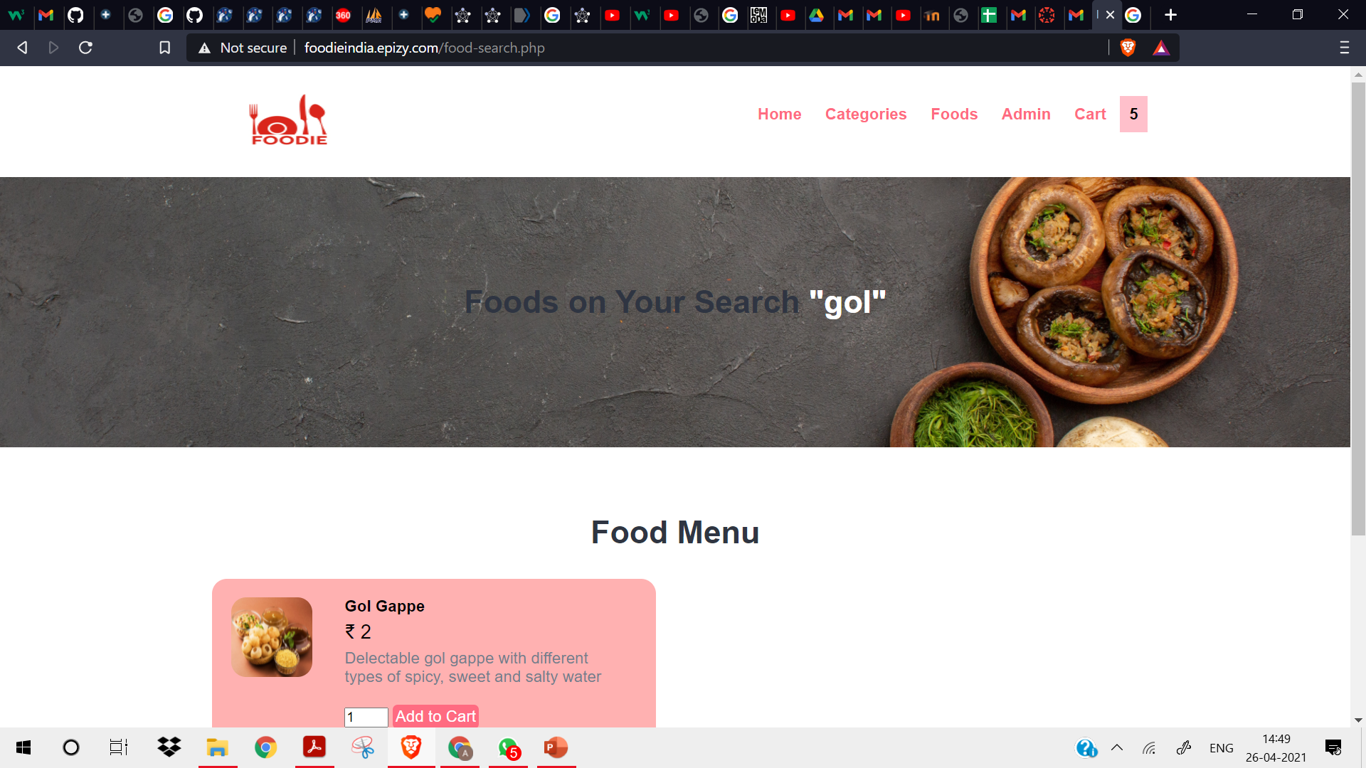
Search Food

Slide 13
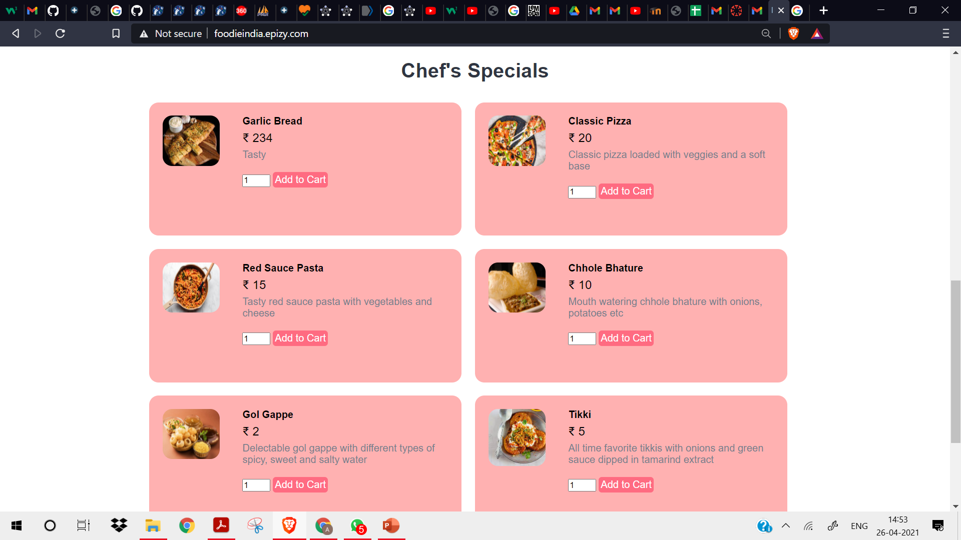
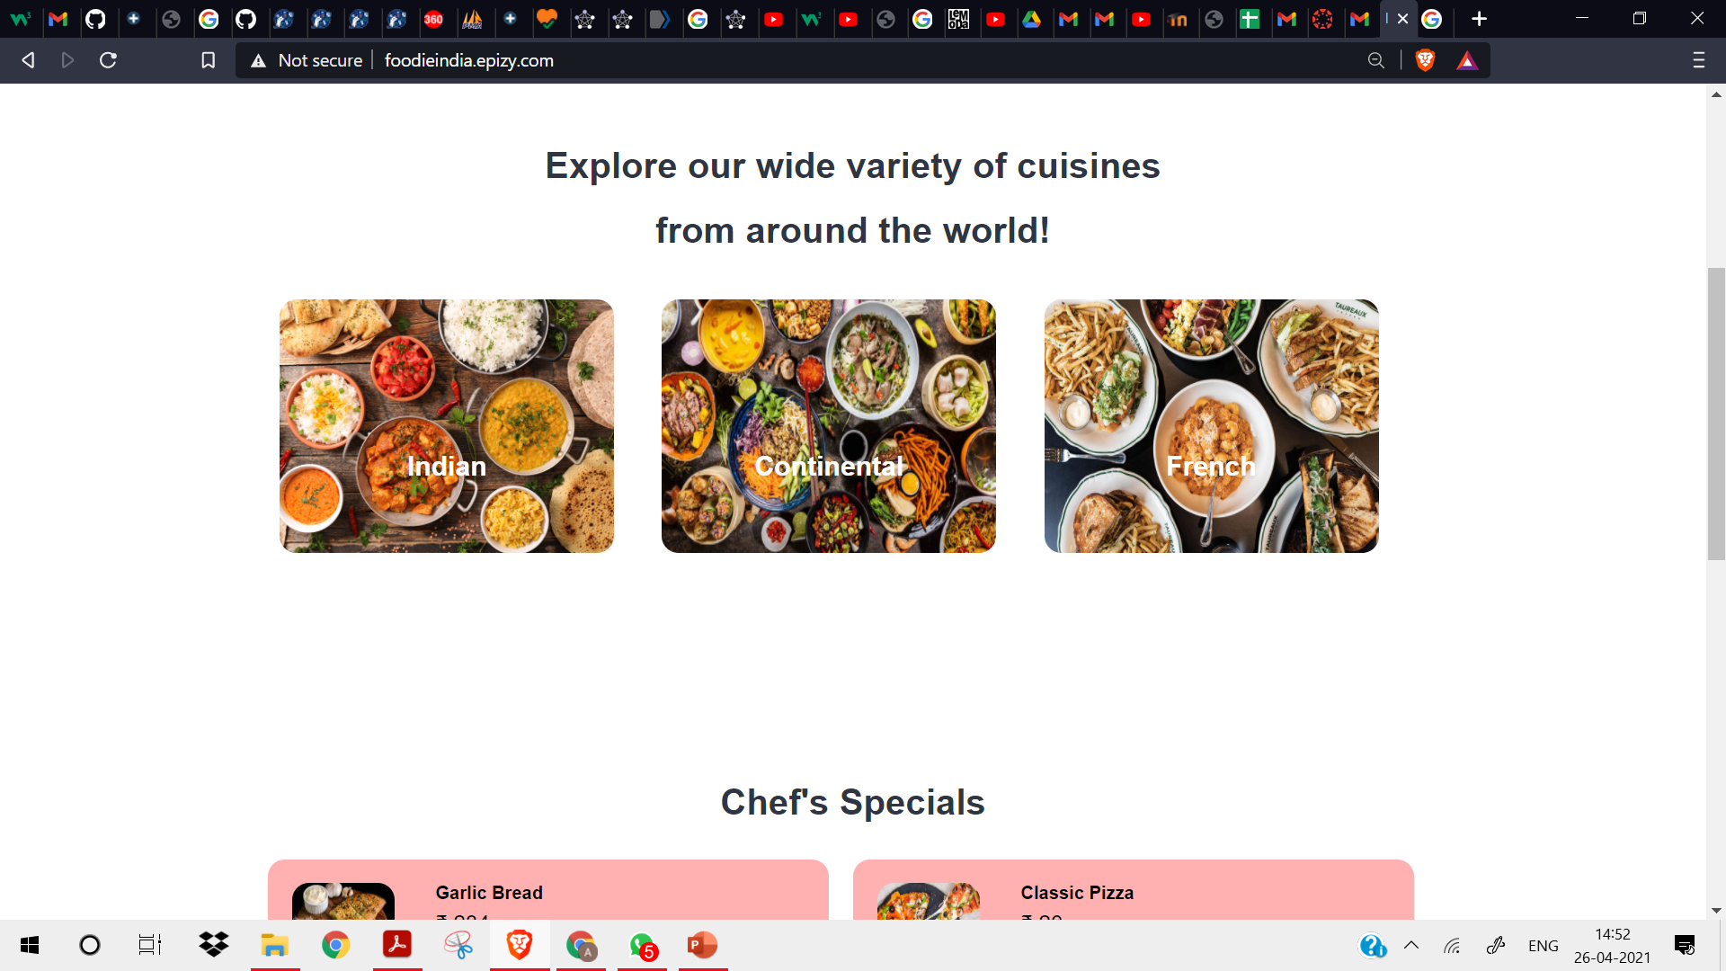
Featured Functionality
From the admin panel –Manage Category/Food, whatever are the top 3 items that are featured, will be displayed on the home page as delicacies

